Slide 1
Trading Performance Report Anton Drozdov

Slide 2
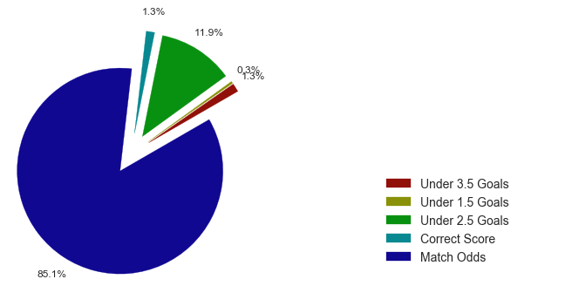
Traded Markets

Slide 3
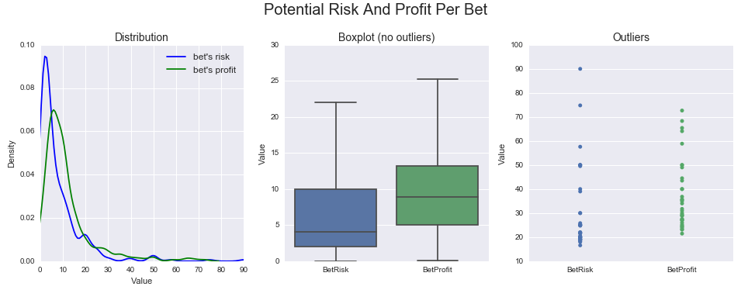
Trading Strategy

Slide 4
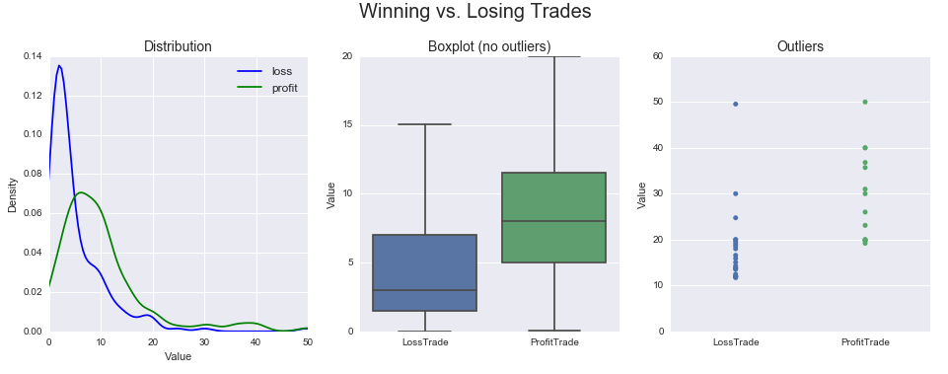
Trading History

Slide 5
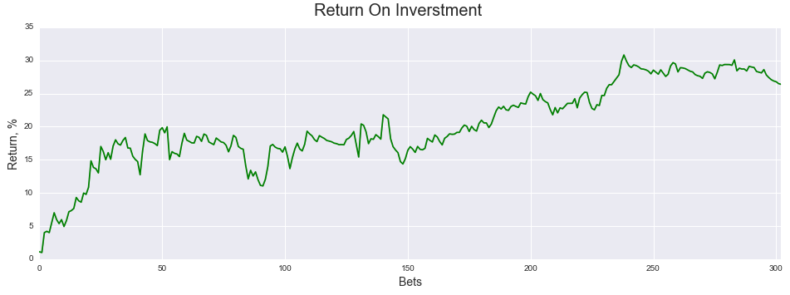
Overall Performance

Slide 6
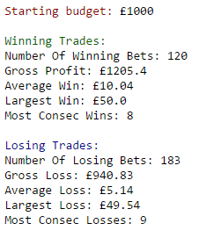
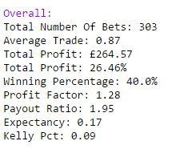
Key Performance Indicators

Slide 7

Repository Explained

